Slide 1
Evolutionary Algorithms and Its Application to Engineering Optimization
By
Professor (Dr.) Jaya Sil
Department of Computer Science and Technology
Bengal Engineering & Science University, Shibpur
West Bengal, India
js@cs.becs.ac.in
global
local

Slide 2
Overview
Introduction to Optimization
Optimization Procedure
Different Optimization Algorithms
Different Global Optimization Algorithms
Evolutionary Algorithms

Slide 3
Optimization
What is optimization?
The process of searching for the optimal solution from a set of candidates to the problem of interest based on certain performance criteria.

Slide 4
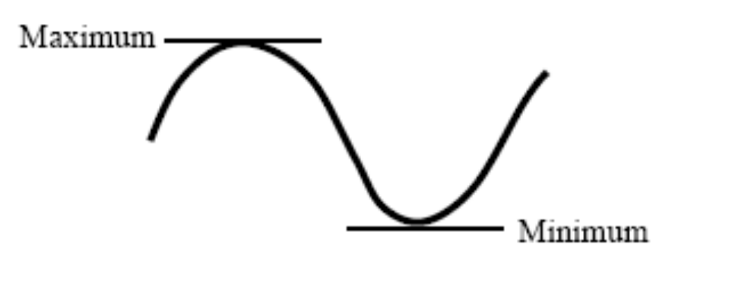
Calculus
Maximum and minimum of a smooth function is reached at a stationary point where its gradient vanishes.

Slide 5

Goal of Optimization
  Find values of the variables that minimize or maximize the objective function while satisfying the constraints.
  Objective Function
X1
Xn
f
Output
f(X)=∑X_{i}²

Slide 6
Component of Optimization Problem
Objective Function: An objective function which we want to minimize or maximize.
      In a manufacturing process, we might want to maximize the profit or minimize the cost.
      In fitting experimental data to a user-defined model, we might minimize the total deviation of observed data from predictions based on the model.
      In designing an inductor, we might want to maximize the Quality Factor and minimize the area.

Slide 7
Component of Optimization Problem
Design Variables: A set of unknowns or variables which affect the value of the objective function.
      In the manufacturing problem, the variables might include the amounts of different resources used or the time spent on each activity.
      In fitting-the-data problem, the unknowns are the parameters that define the model.
      In the inductor design problem, the variables used define the layout geometry of the panel..

Slide 8
Component of Optimization Problem
Constraints: A set of constraints that allow the unknowns to take on certain values but exclude others.
      For the manufacturing problem, it does not make sense to spend a negative amount of time on any activity, so we constrain all the "time" variables to be non-negative.
      In the inductor design problem, we would probably want to limit the upper and lower value of layout parameters and to target an inductance value within the tolerance level.

Slide 9
Are All these ingredients are necessary?
Almost all optimization problems have objective function.
No objective function. In some cases (for example, design of integrated circuit layouts), the goal is to find a set of variables that satisfies the constraints of the model. The user does not particularly want to optimize anything so there is no reason to define an objective function. This type of problems is usually called a feasibility problem.
Variables are essential. If there are no variables, we cannot define the objective function and the problem constraints.
Constraints are not essential. In fact, the field of unconstrained optimization is a large and important one for which a lot of algorithms and software are available. It's been argued that almost all problems really do have constraints.

Slide 10
What We need for optimization
Models: Modeling is the process of identifying objective function, variables and constraints. The goal of models is “insight” not the numbers. A good mathematical model of the optimization problem is needed.
Algorithms: Typically, an interesting model is too complicated to be able to solve in with paper and pencil. An effective and reliable numerical algorithm is needed to solve the problem. There is no universal optimization algorithm.
Algorithm should have robustness (good performance for a wide class of problems), efficiency (not too much computer time) and accuracy (can identify the error)

Slide 11
Flowchart of Optimal Design Procedure
Need for optimization
Choose design variables
Formulate constraints
Formulate objective function
Set up variable bounds
Select an optimization algorithm
Obtain solution(s)

Slide 12
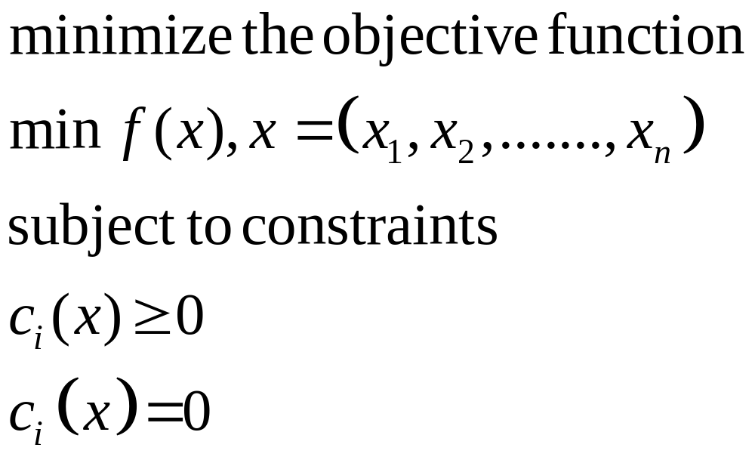
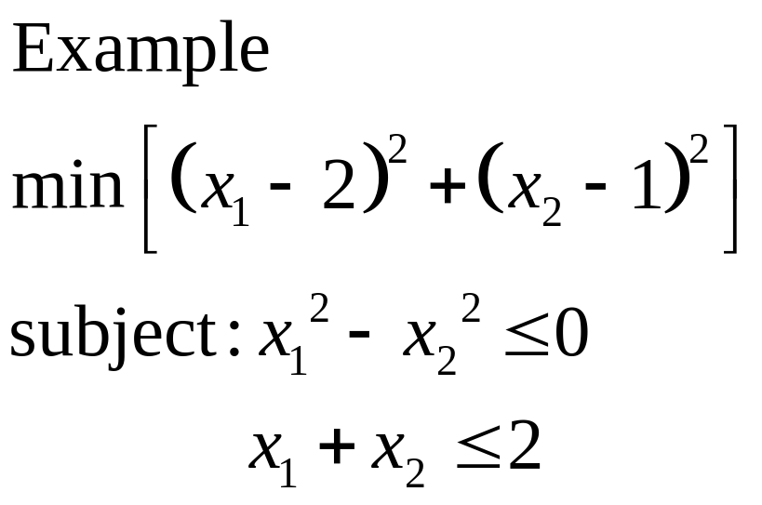
Mathematical Formulation of Optimization Problems

Slide 13
Constraints
Inequality constraints: x₁² – x₂²0
Equality constraints: x₁ = 2

Slide 14
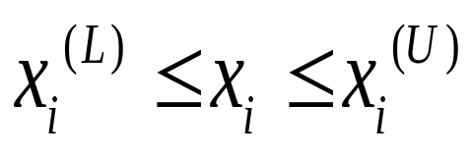
Variable Bounds
Maximum and minimum bounds on each design variable.
Without variable bounds the constraints completely surround the feasible region.
Variable bounds are used to confine the search algorithm within these bounds.
Ex:

Slide 15
Classification of Optimization Methods
Single variable
Multi-variable
Constrained
Non-constrained
Single objective
Multi-objective
Linear
Non-linear

Slide 16
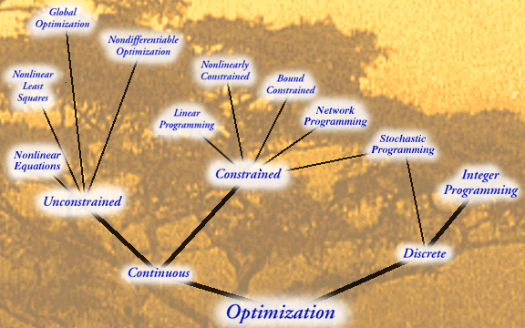
Classification of Optimization Methods

Slide 17
Local and Global Optimizers
A local minimizer, x_{B}*, of the region B, is defined so that:
f(x_{B}*)f(x), x B.
Ex: Gradient based search methods, Newton-Rapson algorithms, Steepest Decent, Conjugate-Gradient algorithms, Levenberg-Marquardt algorithm etc.
Shortcomings: 1) One requires an initial guess to start with. 2) Convergence to an optimal solution depends on the chosen initial guess. 3) Most algorithms tend to get stuck to a sub-optimal solution. 4) An algorithm efficient in solving one optimization problem may not be efficient in solving another one.
The global optimizer, x* , is defined so that f(x*) f(x), x S where S is the search space.
Ex. Simulated Annealing algorithm, Genetic Algorithm, Ant Colony, Geometric Programming, Particle Swarm Optimization etc.

Slide 18
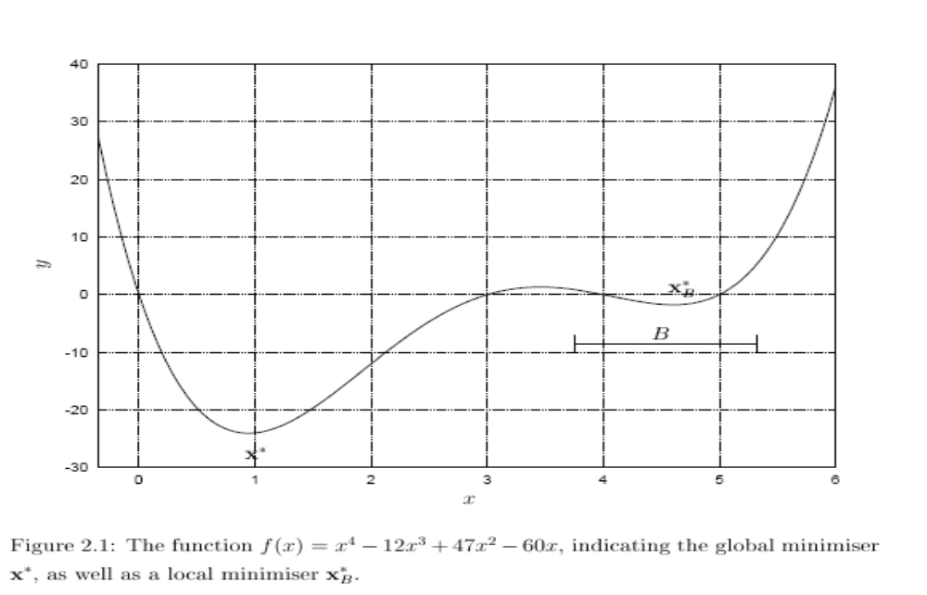
Local and Global Optimizers

Slide 19
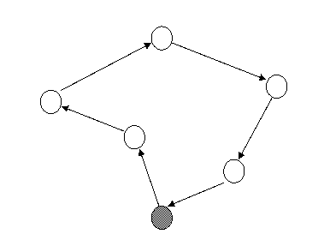
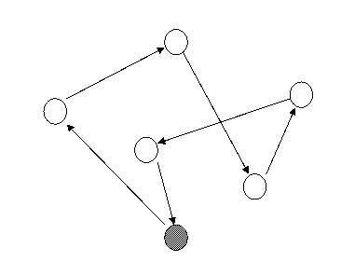
Travelling Salesman Problem
Some Optimization Problems
There are 20!=2,432,902,008,176,640,000 different routes for a 20-city problem.

Slide 20
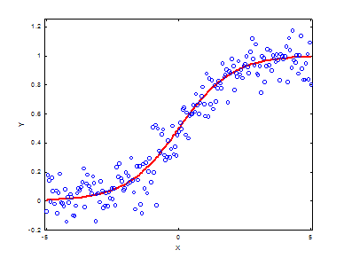
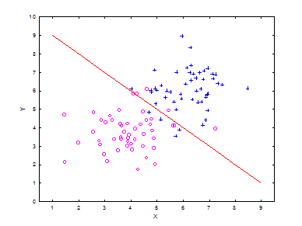
Machine Learning Problems
Some Optimization Problems

Slide 21

Challenge: Local Optima
Some Optimization Problems
f
f
f
0
X
0
X
0
X

Slide 22
How to solve it?
Multimodal
Local Search
f
X
0

Slide 23
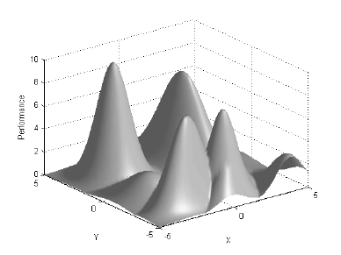
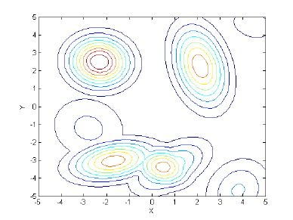
Challenge: Dimensionality
Some Optimization Problems
The size of the search space grows exponentially!

Slide 24
Evolutionary Algorithms
Genetic Algorithm (GA)
Particle Swarm Optimization (PSO)
Differential Evolutionary Algorithm (DE)

Slide 25

Genetic Algorithms

Slide 26
Overview
Historical Background
Problems with Traditional Method
Working principles of GA
GA operators
Concept of Schemata in GA
Benefits of Genetic Algorithms
Issues with Genetic Algorithm
Gas Vs. other Search & Optimization Methods
Advantages of GA
Drawbacks of GA
Applications

Slide 27
Historical Background
Based on the mechanics of biological evolution and using concepts of “Natural Selection” and “Genetic Inheritance” (Darwin 1859)
Initially developed by John Holland, University of Michigan (1970’s)
Holland’s original GA is known as the simple genetic algorithm(SGA)
Provide efficient techniques for optimization and machine learning applications

Slide 28
Properties
A class of stochastic search strategies modeled after evolutionary mechanisms
Particularly well suited for the problems where little is known about the underlying search space
Traditional methods often require some domain knowledge of the problem which might not be readily available.
Search and Optimization Algorithm.
Widely used in business, science and engineering

Slide 29
The Evolutionary Cycle
parents
selection
modification
offspring
population
evaluation
evaluated offspring
Initiatialization
deleted
members
discard

Slide 30
Natural selection
A process called natural selection, ‘selects’ individuals best adapted to the environment.
Those are fittest survive longest.
Characteristics, encoded in genes are transmitted to offspring and tend to propagate into new generations.
An offspring’s characteristics are partially inherited from parents and partly the result of new genes created during the reproduction process.

Slide 31
Terminology
Gene–a single encoding of part of the solution space
Chromosome–a string of genes that represents a solution in the population
Population–the number of chromosomes available to test
Candidate solutions to the optimization problem play the role of individuals in a population (or chromosomes)
Parameter – a variable in the system of interest
Cost/fitness/objective function – A value we are trying to maximize/ minimize

Slide 32
Simple Genetic Algorithm
produce an initial population of individuals
evaluate the fitness of all individuals
while termination condition not met do
select fitter individuals for reproduction
recombine between individuals
mutate individuals
evaluate the fitness of the modified individuals
generate a new population
End while

Slide 33
Representation/Encoding
Encoding of chromosomes: depends entirely on the problem
Representing the solution in the form of a string of bits that conveys the necessary information.
Just as in a chromosome, each gene controls a particular characteristic of the individual, similarly, each bit in the string represents a characteristic of the solution
All kind of alphabets can be used for a chromosome (numbers, characters), but generally a binary alphabet is used
Order of genes on chromosome can be important
Good coding is probably the most important factor for the performance of a GA

Slide 34
Encoding Methods
Binary Encoding – Chromosomes are strings of 1s and 0s and each position in the chromosome represents a particular characteristic of the problem.
Chromosome A
10110010110011100101
Chromosome B
11111110000000011111
Permutation Encoding – Useful in ordering problems such as the Traveling Salesman Problem (TSP). Example. In TSP, every chromosome is a string of numbers, each of which represents a city to be visited.
Chromosome A
1 5 3 2 6 4 7 9 8
Chromosome B
8 5 6 7 2 3 1 4 9

Slide 35
Encoding Methods Contd……
Value Encoding – Used in problems where complicated values, such as real numbers are used.
Chromosome A
1.235 5.323 0.454 2.321 2.454
Chromosome B
(left), (back), (left), (right), (forward)

Slide 36
Encoding Methods Contd……
Octal encoding is uses string made up of octal numbers (0 – 7)
Hexadecimal encoding is uses string made up of Hexadecimal numbers (0 – 9, A – F)
Chromosome A
0 5 6 2 6 4 7 1 4
Chromosome B
1 5 6 7 0 3 1 6 5
Chromosome A
9 5 C 2 A 4 F
Chromosome B
A 0 6 D 2 B 1

Slide 37
GA Operators
- Initialization
- Selection
- Reproduction
- Termination

Slide 38
Initialization
Initially many individual solutions are randomly generated to form an initial population.
The population size depends on the nature of the problem, but typically contains several hundreds or thousands of possible solutions
Traditionally, the population is generated randomly, covering the entire range of possible solutions (the search space).

Slide 39
Selection Methods
select the individuals to be copied over into the next generation
. Roulette-Wheel Selection
. Tournament Selection
. Elitist Selection
. Rank Selection
. Hierarchical Selection

Slide 40

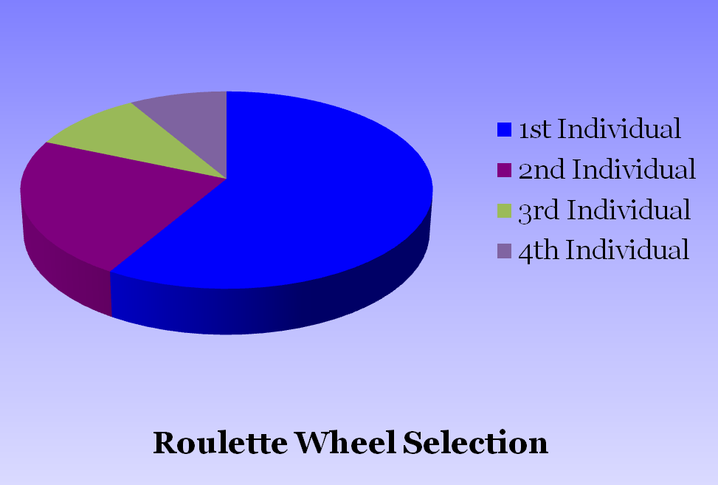
Roulette-Wheel Selection
Each current string in the population has a slot assigned to it which is in proportion to it’s fitness.
We spin the weighted roulette wheel N times (total number of solutions).
Each time Roulette Wheel stops, the string corresponding to that slot is selected.
Strings that are fitter are assigned a larger slot and hence have a better chance of appearing in the new population.
Values
1 | 8.2
2 | 3.2
3 | 1.4
4 | 1.2

Slide 41
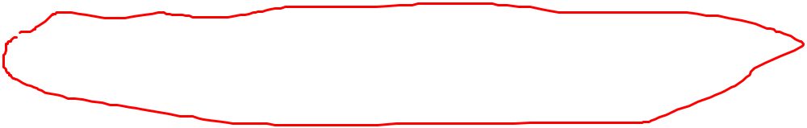
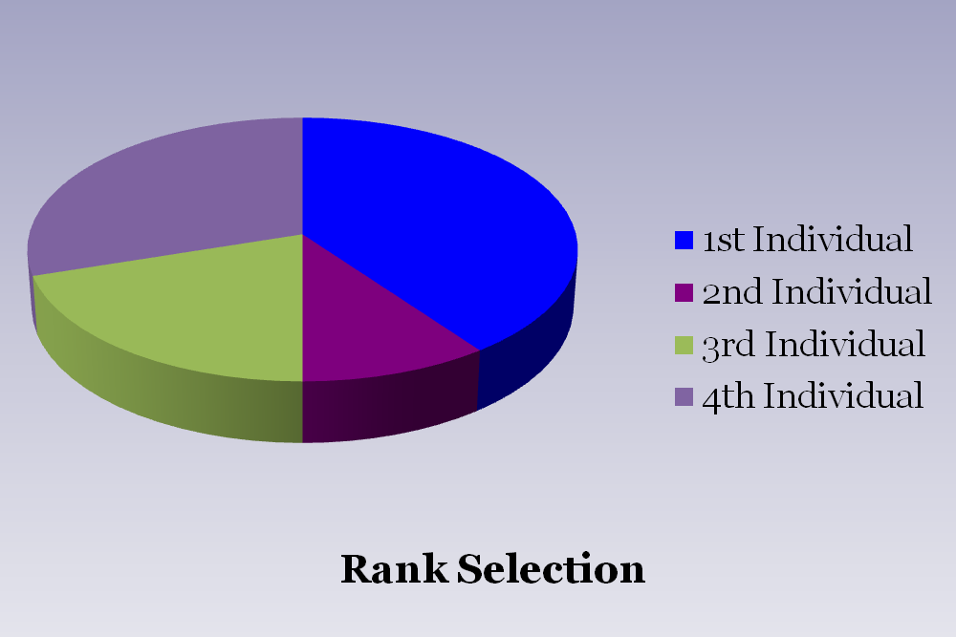
Ranking Selection
Ranks the population and every chromosome receives fitness from the ranking
The worst has fitness 1 and the best has fitness N
Rank based proportioned selection scheme is expected to perform better than fitness proportioned scheme
Values
Rank
1 | 8.2 | 4
2 | -3.2 | 1
3 | 1.4 | 2
4 | -1.2 | 3

Slide 42
Tournament Selection
Select the tournament size n (< N) at random
Pick n strings from the population at random and determine the best in terms of fitness
Only one string is selected in each tournament and N tournaments are played to make the mating pool
Computationally faster than both fitness-based as well as ranked-based proportioned selection schemes

Slide 43
Elitism
This scheme is proposed by Keneth De Jong (1993)
The best chromosome (elite string) or few best chromosomes are copied to the new population
The rest is done in any classical way
Preserve best population may be lost during reproduction
This significantly improves the GA’s performance

Slide 44
Hierarchical Selection
Individuals go through multiple rounds of selection each generation
Lower-level evaluations are faster and less discriminating, while those that survive to higher levels are evaluated more rigorously.
ADVANTAGE: Efficient usage of computing time

Slide 45
Crossover
crossover is a genetic operator used to vary the characteristics of a chromosome or chromosomes from one generation to the next.
Two chromosomes (strings) exchange their genetic information (bits) to produce a new offspring which possesses both their characteristics.
Two strings are picked from the selected pool at random called parents.
The parents will participate in crossover by tossing a coin, whose probability of head is p_{c}

Slide 46
Crossover
The crossover probability p_{c} is generally near to 1 so that almost all parents can participate in crossover
The process is simulated by random number generation between 0.0 and 1.0
If the random number is less or equal to p_{c} the parent will participate in crossover

Slide 47
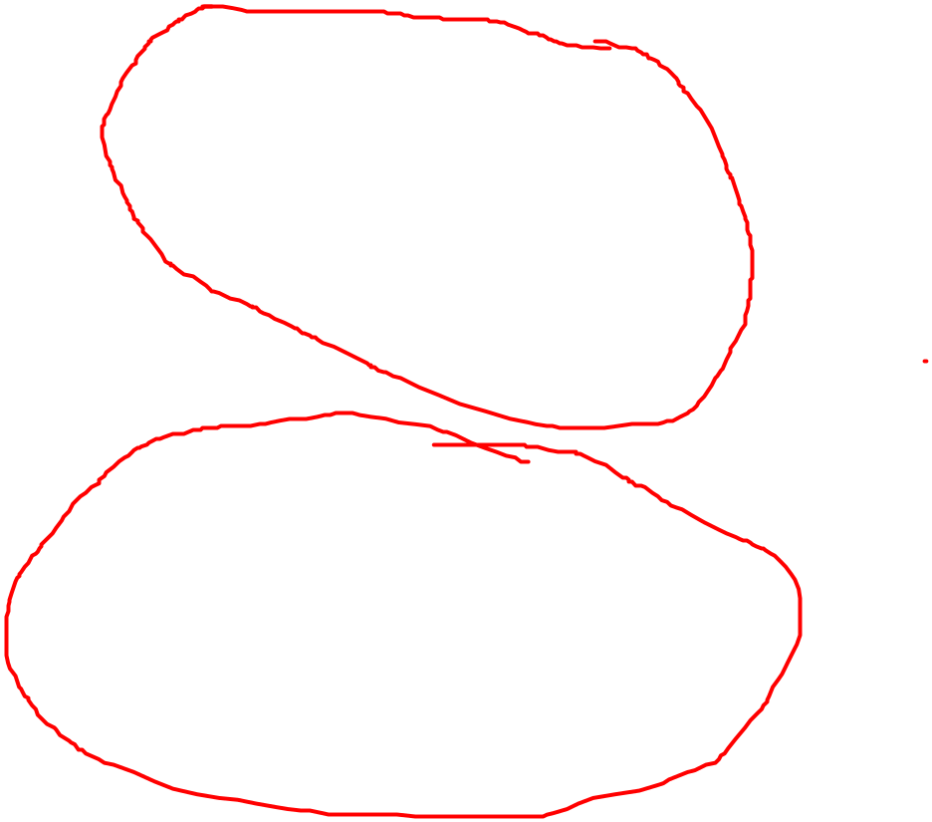
Single Point Crossover
A random point is chosen on the individual chromosomes (strings) and the genetic information is exchanged at this point.
Parent 1
Parent 2
Offspring 1
Offspring 2
One Point Crossover

Slide 48
Two Point Crossover
Two or more random points are chosen on the individual chromosomes (strings) and the genetic information is exchanged in between these points.
Parent 1
Parent 2
Offspring 1
Offspring 2
Two Point Crossover

Slide 49
Uniform Crossover
A more general version of the multi-point crossover.
Each gene (bit) is selected randomly from one of the corresponding genes of the parent chromosomes.
Parent 1
Parent 2
Offspring
Uniform Crossover

Slide 50

Comparison of crossover operators
Disruption rate of crossover depends on both recombination potential and exploratory power.
Disruption rate increases with the number of crossover points for both multipoint and uniform crossover
For a large search space, uniform crossover is performed better than single/multi point crossover
A single point crossover may perform better than two-point crossover.

Slide 51
Mutation
Mutation- is a genetic operator used to maintain genetic diversity from one generation of a population of chromosomes to the next. It is analogous to biological mutation.
Mutation Probability- determines how often the parts of a chromosome will be mutated.
A common method of implementing the mutation operator involves generating a random variable for each bit in a sequence. This random variable tells whether or not a particular bit will be modified.

Slide 52
Mutation
Mutation is mainly used to maintain the genetic diversity.
Parent
Offspring

Slide 53
Schema Analysis
A simple way to view the standard GA
They have made possible proofs of some interesting theorems
They provide a nice introduction to algorithmic analyses
Schema – a template made up of a string of 1s, 0s, and *s,
where * is used as a wild card that can be either 1 or 0
For example, H = 1 * * 0 * 0 is a schema.
It has eight instances (one of which is 101010)

Slide 54
Schema Analysis Contd……..
Order, o ( H ) , the number of non-*, or defined, bits (in example 3)
Defining length, d ( H ) , greatest distance between two defined bits
(in example H has a defining length of 3)
Let S be the set of all strings of length l.
There is 3^{l} possible schemas on S, but 2^{2l} different subsets of S
Schema cannot be used to represent every possible population within S, but forms a representative subset of the set of all subsets of S

Slide 55

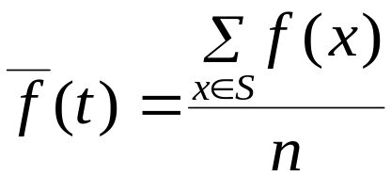

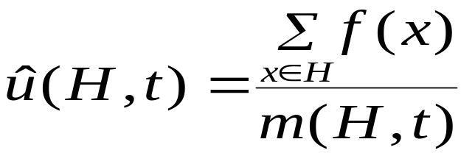
Schema Analysis Contd…..
The end-of-iterations conditions:
expected number of instances of schema H as we iterate the GA
m(H, t) – the number of instances of H at time t
f(x) – fitness of chromosome x
- average fitness at time t :
, n=|S|
- average fitness of instances of H at time t:

Slide 56
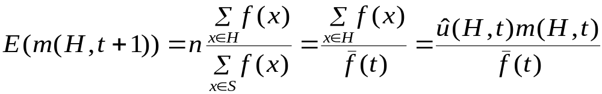


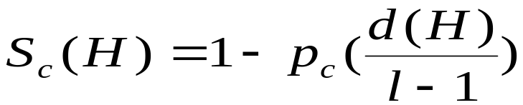
Schema Analysis Contd…..
If we completely ignore the effects of crossover and mutation,
we get the expected value:
Now we consider only the effects of crossover and mutation,
which lower the number of instances of H in the population.
Then we will get a good lower bound on E(m(H,t+1))
- probability that a random crossover bit is between the defining bits of H
- probability of crossover occurring

Slide 57



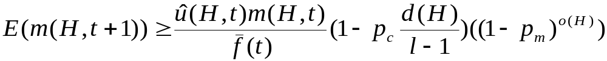
Schema Analysis Contd…..
- probability of an instance of H remaining the same after mutation; it is dependent on the order of H
- probability of mutation
With the above notation , we have:
Schema Theorem, provided by John Holland

Slide 58
Benefits of Genetic Algorithms
Concept is easy to understand
Modular–separate from application (representation); building blocks can be used in hybrid applications
Supports multi-objective optimization
Good for “noisy” environment
Always results in an answer, which becomes better and better with time
Can easily run in parallel
The fitness function can be changed from iteration to iteration, which allows incorporating new data in the model if it becomes available

Slide 59
Issues with Genetic Algorithms
Choosing parameters:
–Population size
–Crossover and mutation probabilities
–Selection, deletion policies
–Crossover, mutation operators, etc.
–Termination criteria
Performance:
–Can be too slow but covers a large search space
–Is only as good as the fitness function

Slide 60
GA Vs. other Search & Optimization Methods
Multiple solutions can be obtained without extra effort.
GAs are implicitly parallel and can be implemented on parallel machines.
GAs are quite successful in locating the regions containing optimal solution(s), if not the optimum solution itself.
GAs can solve problems involving large time domain.

Slide 61
Advantages of GAs
Concept is easy to understand.
Minimum human involvement.
Computer is not learned how to use existing solution,
but to find new solution!
Can handle the integer/mixed-integer programming problems effectively
Can optimize discontinuous objective function also
Supports multi-objective optimization
Inherently parallel; easily distributed
Many ways to speed up and improve a GA-based application as knowledge about problem domain is gained
Easy to exploit previous or alternate solutions

Slide 62
Drawbacks of GAs
A practical disadvantage of the genetic algorithm involves longer running times on the computer. Fortunately, this disadvantage continues to be minimized by the ever-increasing processing speeds of today's computers.
Till today there is no mathematical convergence proof of GA
An user must have a proper knowledge of how to select an appropriate set of GA parameters

Slide 63
Applications of Genetic Algorithms
Optimization–numerical and combinatorial optimization problems, e.g. traveling salesman, routing, graph colouring and partitioning
Bioinformatics- protein structure prediction, gene expression
Robotics–trajectory planning
Machine learning–designing neural networks, classification and prediction, e.g. prediction of weather or protein structure,
Signal processing–filter design
Design–semiconductor layout, aircraft design, communication networks
Automatic programming–evolve computer programs for specific tasks, design cellular automata and sorting networks
Economics–development of bidding strategies, emergence of economics markets
Immune systems–model somatic mutations
Ecology–model symbiosis, resource flow
Population genetics–“Under what condition will a gene for recombination be evolutionarily viable?”

Slide 64
References:
Introduction to Genetic Algorithms, M. Mitchell, MIT press, 1996
Genetic Algorithms in Search, Optimisation and Machine Learning, D.E. Goldberg,
Addison-Wesley 1989
An introduction to Genetic Algorithms for Scientists and Engineers, D. A. Coley,
World Scientific 1999.
Optimization for Engineering Design – Algorithms and Examples, Kalyanmoy Deb,
P.H.I.

Slide 65

Particle Swarm Optimization

Slide 66
Overview
What is swarm intelligence?
Biological inspirations
Particle swarm definition
PSO algorithm
Applications

Slide 67
Biological Inspirations
PSO model is derived from real world interactions
Flocks of birds converge to food sources
Schools of fish evade predators
Any similar interactions with social and psychological basis with objectives

Slide 68
Swarm Intelligence
Population of simple agents with simple Mathematical formula
No centralized control of agent behavior
High level phenomena emerge from low level specification of rules
Ants, Bees, Cellular Automata
PSO is a metaheuristic algorithm as it makes few or no assumptions about the problem being optimized and can search very large spaces of candidate solutions

Slide 69


Natural Models
Social-Psychological behaviors of animals
How can birds or fish exhibit such a coordinated collective behavior?

Slide 70
PSO Definition
PSO is a robust stochastic optimization technique based on the movement and intelligence of swarms
PSO applies the concept of social interaction to problem solving
It was developed in 1995 by James Kennedy (social-psychologist) and Russell Eberhart (electrical engineer).
Simple algorithm, easy to implement and few parameters to adjust mainly the velocity and position
A “swarm” is an apparently disorganized collection (population) of moving individuals that tend to cluster together while each individual seems to be moving in a random direction

Slide 71
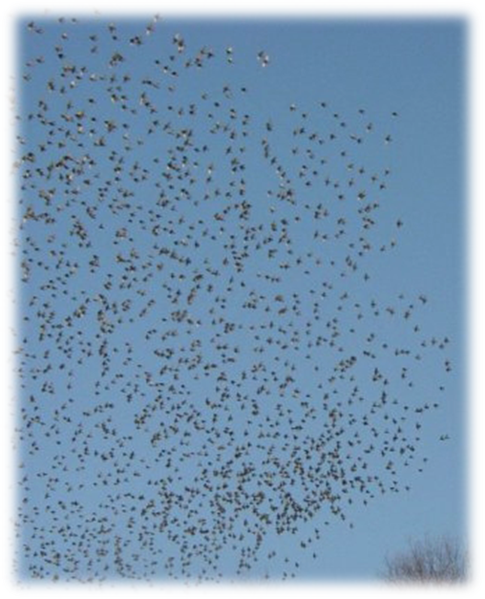
Concept
Uses a number of agents (particles) that constitute a swarm moving around in the search space looking for the best solution
Each particle in search space adjusts its “flying” according to its own flying experience as well as the flying experience of other particles

Slide 72
Concept
Each agent (particle) combines self-experiences with social experiences
PSO do not guarantee an optimal solution is ever found.
PSO does not use the gradient of the problem being optimized, which means PSO does not require that the optimization problem must be differentiable as is required by classic optimization methods such as gradient descent and quasi-newton methods.

Slide 73
Concept
Each particle is treated as a point in a search space which adjusts its “flying” according to its own flying experience as well as the flying experience of other particles.
Each particle keeps track of its coordinates in the solution space which are associated with the best solution (fitness) that has achieved so far by that particle. This value is called personal best, pbest
Another best value that is tracked by the PSO is the best value obtained so far by any particle in the neighborhood of that particle. This value is called gbest

Slide 74
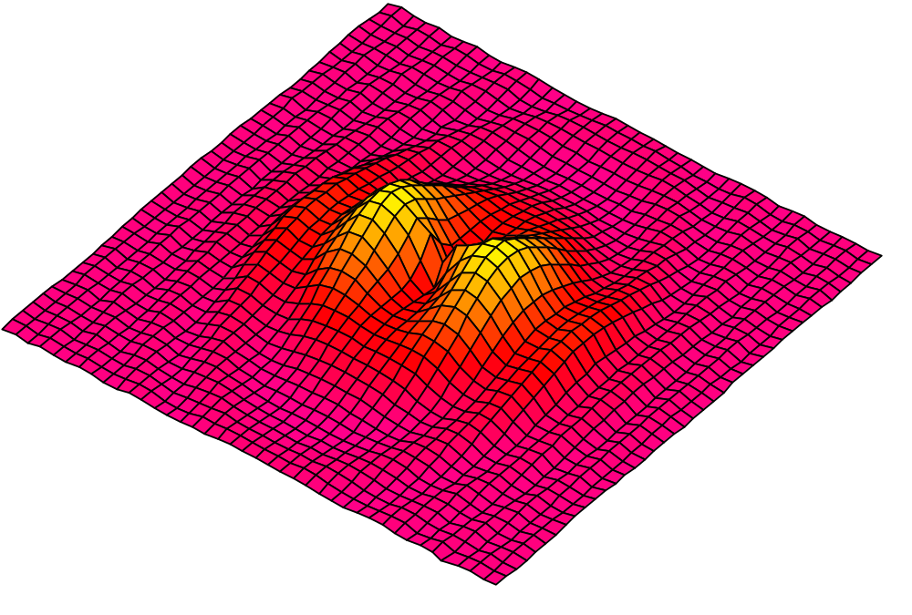
PSO: Algorithm - Neighborhood
geographical
Geographical
Social

Slide 75
PSO: Algorithm - Neighborhood
Global
global

Slide 76
Concept of modification of a searching point by PSO
My best perf.
i-proximity
Here I am!
The best perf. of my neighbours
x
g-proximity
v
The basic concept of PSO lies in accelerating each particle toward its pbest and the gbest locations, with a random weighted acceleration at each time step

Slide 77
particle i is represented as X_{i} = (x_{i1}, x_{i2}, . . ., x_{iD}), which represents a potential solution to a problem in D-dimensional space.
Each particle keeps a memory of its previous best position Pbest, and a velocity along each dimension, represented as vi = (vi1, vi2, . . . , viD).
At each iteration, the position of the particle with the best fitness value in the search space is used to adjust the velocity along each dimension, and that velocity is then used to compute a new position for the particle

Slide 78
Introduction to the PSO: Concept
Each particle adjusts its travelling speed dynamically corresponding to the flying experiences of itself and its colleagues
Each particle modifies its position according to:
  its current position
    its current velocity
    the distance between its current position and pbest
    the distance between its current position and gbest

Slide 79
What a particle does
Each particle tries to modify its position:
    the current positions and the current velocities
    the distance between the current position and pbest
    the distance between the current position and the gbest
The modification of the particle’s velocity and position can be mathematically modeled:
V_{i}^{t+1} = wV_{i}^{t} +c₁ rand₁().(pbest_{i}-x_{i}^{t}) + c₂ rand₂(). (gbest-x_{i}^{t}) (1)
where, v_{i}^{t} : velocity of agent i at iteration t, w: weighting function, c_{j} : weighting factor, rand : uniformly distributed random number between 0 and 1, x_{i}^{t} : current position of agent i at iteration k, pbest_{i} : pbest of agent i, gbest: gbest of the group.
X_{i}^{t+1} = X_{i}^{t} + V_{i}^{t+1} (2)

Slide 80
Velocity Update
Velocity at next step composed of three components
Includes stochastic multipliers (r₁ and r₂) which explore search space
Position(t + 1) = Position(t) + Velocity(t+1)
inertia
cognitive
social

Slide 81
Inertia Component
“The tendency to stay moving in the current direction”
Value ranges from: 0 ≤ w ≤ 1
Empirically determined but generally a mid range value is used
inertia
cognitive
social

Slide 82
Cognitive Component
“A particle’s memory; tends to return to known good regions”
Values range from: 0 ≤ c₁ ≤ 2
Usually experimentation necessary as cognition depends on the fitness landscape
inertia
cognitive
social

Slide 83
Social Component
“Causes the particle to move to the best known region the swarm has found”
Values range from: 0 ≤ c₂ < 2
Modifications to global best could be social groupings, islands, neighborhoods, etc.
inertia
cognitive
social

Slide 84
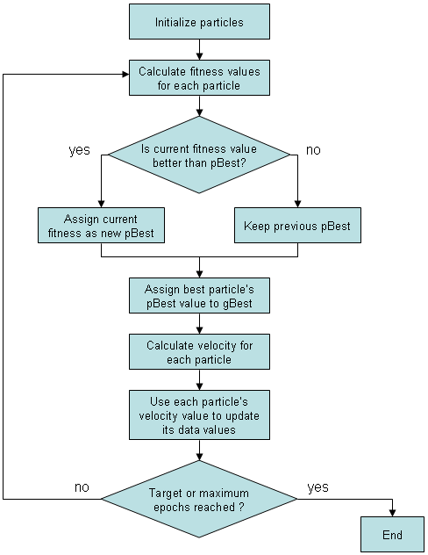
General PSO Algorithm

Slide 85
Applications
Optimization of function or search space
Biomedical applications
Bioinformatics
Hybrid strategies for evolving ANN weights
Most applications which GA is able to solve !

Slide 86
Comparison with other evolutionary computation techniques
Unlike in genetic algorithms, evolutionary programming and evolutionary strategies, in PSO, there is no selection operation
All particles in PSO are kept as members of the population through the course of the run
PSO is the only algorithm that does not implement the survival of the fittest
No crossover operation in PSO
No mutation operation in PSO
In other EC’s balance between the global and local search can be adjusted through the strategy parameter while in PSO the balance is achieved through the inertial weight factor (w) of the velocity updating equation

Slide 87
Variants of PSO
Discrete PSO ……………… can handle discrete binary variables
Hybrid PSO…………. Utilizes basic mechanism of PSO and the natural selection mechanism, which is usually utilized by EC methods such as GAs

Slide 88
Particle swarm optimization: Research issues
A number of research directions are currently pursued:
Matching algorithms (or algorithmic components) to problems
Application to different kind of problems (dynamic, stochastic, combinatorial)
Parameter selection. (How many particles, which topology?)
Identification of ”state-of-the-art” PSO algorithms
New variants (modifications, hybridizations)
Theoretical aspects (particles behavior, stagnation)
Bioinformatics research (Protein Structure Prediction, RNA Prediction, DNA Prediction)

Slide 89
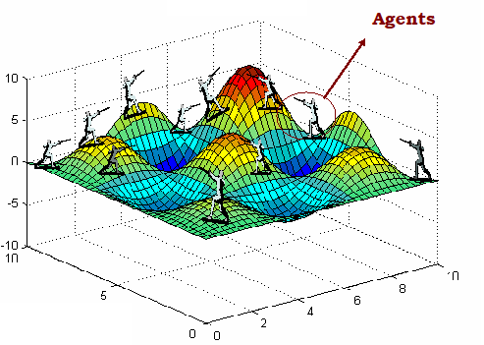
Differential Evolution

Slide 90
Motivation for Differential Evolution (DE)
A stochastic population-based optimization algorithm for continuous function optimization (Storn and Price, 1995)
Developed to optimise real parameter, real valued functions
Continually exhibited remarkable performance in competitions on different kinds of optimization problems like dynamic, multi-objective, constrained, and multi-modal problems
The key element distinguishing DE from other population-based techniques is differential mutation operator

Slide 91
Why use Differential Evolution?
Global optimization is necessary in fields such as engineering, statistics and finance
But many practical problems have objective functions that are non-differentiable, non-continuous, non-linear, noisy, flat, multi-dimensional or have many local minima, constraints or stochasticity.
Such problems are difficult if not impossible to solve analytically
DE can be used to find approximate solutions to such problems

Slide 92
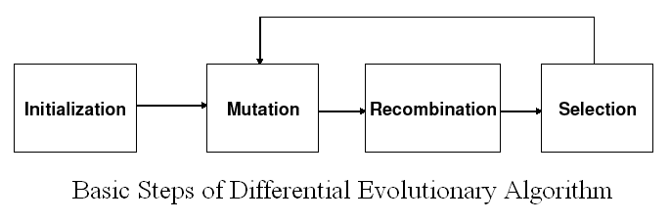
Basic DE algorithms – a first look
DE is an Evolutionary Algorithm

Slide 93
Notation
Suppose we want to optimize a function with D real parameters
We must select the size of the population (it must be at least 4)
The parameter vectors:
x_{i,G} = [x_{1,i,G,} x_{2,i,G,} . . . x_{n,i,G}] i = 1, 2, . . . , N
where G is the generation number
Vector differences is used for perturbing the vector population.
DE adds the weighted difference between two population vectors to a third vector

Slide 94
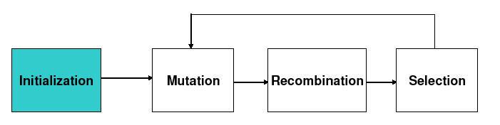
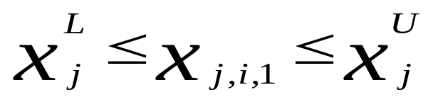
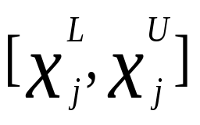
Initialization
First, all parameter vectors in a population are randomly initialized and evaluated using the fitness function.
Define upper and lower bounds for each parameter:
Randomly select the initial parameter values uniformly on the intervals

Slide 95
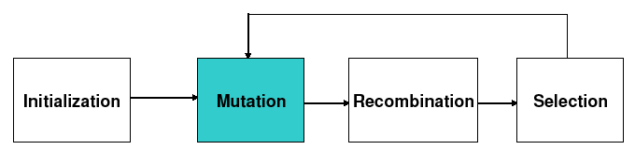
Mutation
Mutation expands the search space
For each vector select three other parameter vectors randomly
Add the weighted difference of two of the vectors to the third
V_{i,G+1} = X_{r1,G} + F(X_{r2,G} − X_{r3,G})
where V_{i,G+1} is a mutant vector; r1,r2,r3 ∈ {1, 2, …, NP}, random integer mutually different and different from index i then NP ≥ 4
The mutation factor F is a constant from [0, 2]
V_{i,G+1} is called the donor vector

Slide 96
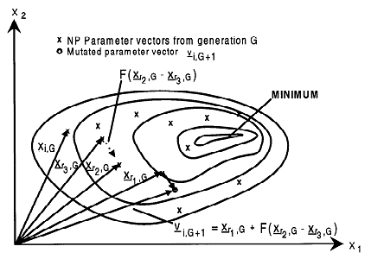
DE Mutation Operator
An example of a two-dimensional cost function showing its contour lines and the process for generating v_{i,G+1} by different vectors

Slide 97
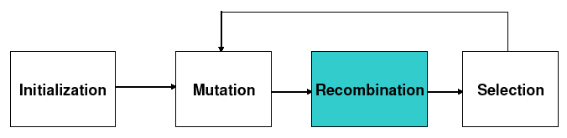
Recombination/Crossover
Crossover is introduced to increase the diversity of the perturbed parameter vectors
Recombination incorporates successful solutions from the previous generation
The trial vector U_{i,G+1} is developed from the elements of the target vector, X_{i,G}, and the elements of the donor vector, V_{i,G+1}
Elements of the donor vector enter the trial vector with probability CR
Mainly two crossover:
i) Binomial Crossover
ii) Exponential Crossover

Slide 98
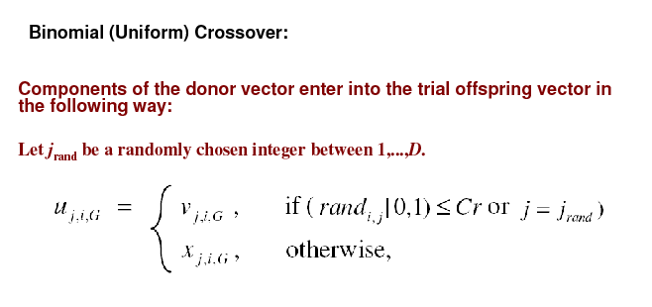
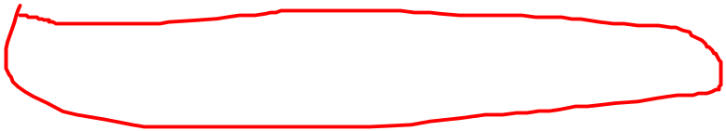

Slide 99
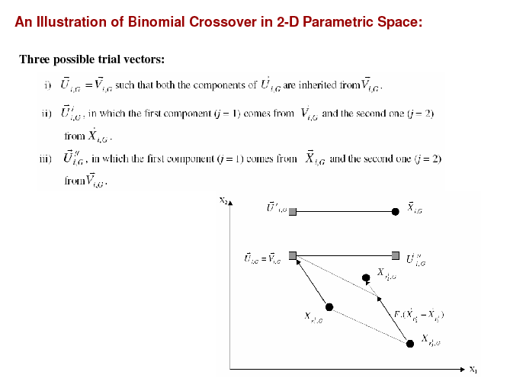

Slide 100

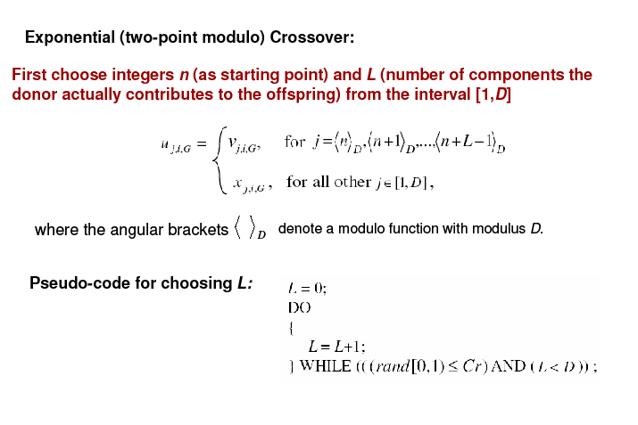

Slide 101
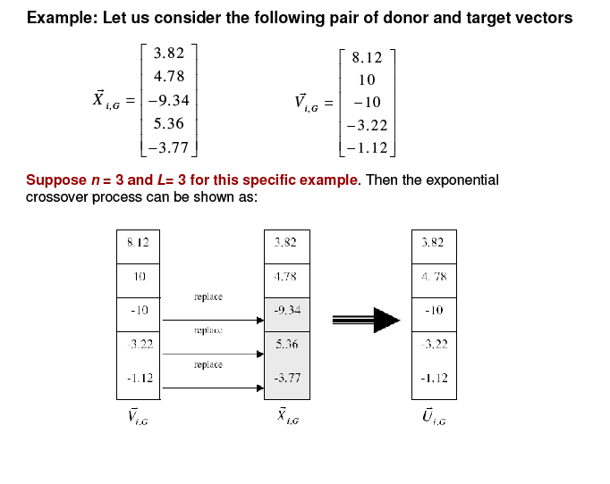

Slide 102
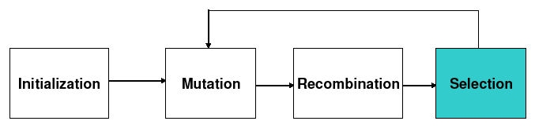
Selection
The target vector X_{i,G} is compared with the trial vector V_{i,G+1} and the one with the lowest function value is admitted to the next generation
X_{i,G+1}= U_{i,G} if f(U_{i,G}) ≤ f(X_{i,G})
= X_{i,G} otherwise
for i= 1,2,….,NP
Mutation, recombination and selection continue until some stopping criterion

Slide 103
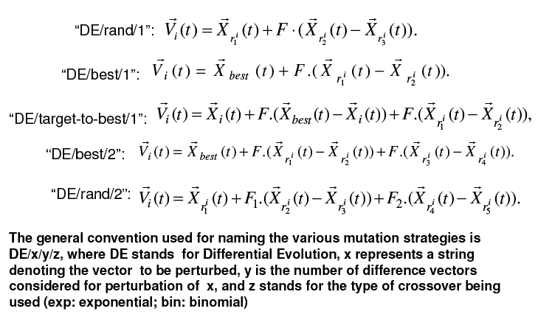
Frequently used DE mutation schemes

Slide 104
DE Control Parameters
Population size
Larger - increases the reliability - slower convergence
suggested ranges - 5 x n to 10 x n
F (scaling factor)
Range (0,1+)
Large – decreases convergence speed – escape local optima
CR (cross-over rate)
Range (0,1)
Large - speeds up convergence
Range (0, 0.2) – good for separable problems
Range (0.9, 1.0) – good for linked and multi-modal
problems

Slide 105
Protein Structure Prediction: An Application
Vector Encoding
Initial Population
Repair Algorithm
DE Control Parameters for PSP

Slide 106
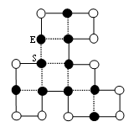
Vector Encoding
Conformation of a protein on lattice represented by internal
Coordinates
Absolute Internal Coordinate: According to the axis of the lattice
Absolute direction in 2D Lattice: {N, S, E, W}^{n-1}
Relative Internal Coordinate: according to the previous amino acid
movements
Relative direction in 2D Lattice: {F, L, R}^{n-1}
For Example:
Absolute Encoding:
WSSENESEENWNWNENWWS
Relative Encoding:
LLFLLRRLFLLRLRRLLFL

Slide 107
Vector Encoding Continue
In DE, every individual are real valued vectors which are decoded
in to a specific conformation of a protein on the 2D square lattice.
An adaptation concept is necessary for encoding and decoding the
sequence of movements of a protein on the lattice
is the j^{th} element of individual and P is the string representing the sequence of movements of the conformation and α< β < γ < δ arbitrary constants in

Slide 108
Initial Population
Creating initial population randomly using the relative internal
coordinate encoding scheme.
The conformation of a protein represent by a string of alphabets
F, L, and R.
The conformations of proteins may be feasible (no overlapping
of amino acids on the lattice) or infeasible (overlapping of
amino acids).
Applying Differential Evolutionary algorithm and every
individual is real valued vector. Thus, using the above defined
genotype-phenotype mapping we convert the string of
conformation to real valued vector.

Slide 109
DE Control Parameters
In DE, larger population size explores the search space but
decrease the probability to find the correct search direction
The exploration and exploitation of the DE algorithms is
very sensitive to the selection of mutation strategy
The most widely used strategy are DE/rand/1/- and
DE/best/1/-
The first strategy is responsible for exploring the search
space and the other is used for fast convergence to global
optima
Consider one difference vector to be perturbed because
more difference vectors increase the convergence speed at
the cost of possibility to trap at local optima

Slide 110
DE Control Parameters
The large values of F are used for escaping the solution
from a local optimum and small values provide rapid
convergence but high probability to trap to local optima
Therefore, we used F value from 0.5 to 0.9 at each
generation to generate the donor vector
If some components of the donor vector violate its limits,
then we set the corresponding component to a random
value within the specified limits of that component.

Slide 111
Results and Analysis
Benchmark Sequences:
Seq.No. | HP Chain | Length | C_{max}
S1 | HPHP²H²PHP²HPH²P²HPH | 20 | 9
S2 | H²P²HP²HP²HP²HP²HP²HP²H² | 24 | 9
S3 | P²HP²H²P⁴H²P⁴H²P⁴H² | 25 | 8
S4 | P³H²P²H²P⁵H⁷P²H²P⁴H²P²HP² | 36 | 14
S5 | P²HP²H²P²H²P⁵H¹⁰P⁶H²P²H²P²HP²H⁵ | 48 | 23
S6 | H²PHPHPHPH⁴PHP³HP³HP⁴HP³HP³HPH⁴PHPHPHPH² | 50 | 21
S7 | P²H³PH⁸P³H¹⁰PHP³H¹²P⁴H⁶PH²PHP | 60 | 36
S8 | H¹²PHPHP²H²P²H²P²HP²H²P²H²P²HP²H²P²H²P²HPHPH¹² | 64 | 42

Slide 112
Results and Analysis
Comparison of Results using different approaches:
Seq. No. | Length | C_{max} | GA[14] | MMA[15] | Hybrid DE[16] | DE[5] | Our Approach
 |  |  |  |  |  |  | Max | Average
S1 | 20 | 9 | 9 | 9 | 9 | 9 | 9(50) | 9.00
S2 | 24 | 9 | 9 | --- | 9 | 9 | 9(50) | 9.00
S3 | 25 | 8 | 8 | 8 | 8 | 8 | 8(50) | 8.00
S4 | 36 | 14 | 14 | 14 | 14 | 14 | 14(50) | 14.00
S5 | 48 | 23 | 22 | 22 | 23 | 23 | 23(45) | 22.88
S6 | 50 | 21 | 21 | 21 | 21 | 21 | 21(50) | 21.00
S7 | 60 | 36 | 34 | --- | 35 | 35 | 35(42) | 34.82
S8 | 64 | 42 | 37 | 39 | 42 | 42 | 39(40) | 38.80

Slide 113
DE research trends
Digital Filter Design
Multiprocessor synthesis
Neural network learning
Diffraction grating design
Crystallographic characterization
Beam weight optimization in Radiotherapy
Heat transfer parameter estimation in a trickle bed reactor
Electricity market simulation
Scenario-Integrated Optimization of Dynamic Systems
Optimal Design of Shell-and-Tube Heat Exchangers
Optimization of Non-Linear Chemical Processes
Optimum planning of cropping patterns
Optimization of Water Pumping System
Optimal Design of Gas Transmission Network
Differential Evolution for Multi-Objective Optimization
Bioinformatics

